Slide 1


Student Details
Name: Nikshep rohan kurapati
SkillsBuild Email ID: rohankurapati99@gmail.com
College Name: vellore institute of technology
College State: Andhra Pradesh
Internship Domain and Internship Start and End Date: Artificial intelligence / 18 aug 2023 – 30 sep 2023

Slide 2
PROJECT TITLE/Problem Statement
Title: Sentiment Analysis of Restaurant Reviews.
Problem Statement: In the era of online restaurant reviews, understanding customer sentiments from vast amounts of unstructured text data is a pressing challenge for the hospitality industry. This project aims to develop a robust sentiment analysis system using machine learning techniques. The objective is to automatically categorize restaurant reviews into positive, negative, or neutral sentiments, empowering businesses to efficiently gauge customer feedback and enhance their services accordingly. The project will involve data collection, preprocessing, model development, and optional deployment of a web application, with a focus on ensuring ethical data handling and model interpretability.

Slide 3
AGENDA
The successful implementation of this sentiment analysis solution will offer restaurants and hospitality businesses a powerful tool for data-driven decision-making. By automating sentiment analysis of customer reviews, businesses can gain valuable insights, improve customer satisfaction, and make informed operational adjustments. Furthermore, this project lays the foundation for future enhancements in fine-grained sentiment analysis, allowing for more nuanced feedback analysis and targeted improvements in the restaurant industry.

Slide 4
PROJECT OVERVIEW
The purpose of our project is to develop a robust Sentiment Analysis system tailored to restaurant reviews. In an age where online customer feedback has a profound impact on the restaurant industry, our project aims to create a powerful tool that automatically assesses and categorizes sentiments expressed in these reviews. By doing so, we strive to provide restaurants and businesses in the hospitality sector with valuable insights to enhance their services, improve customer satisfaction, and make data-driven decisions.
Objectives:
Automation
Improved Decision-Making
Enhanced Customer Experience
Ethical Responsibility

Slide 5
WHO ARE THE END USERS of this project?
Restaurant Owners and Managers: Restaurant owners and managers are primary users because they can directly benefit from insights into customer feedback. They can use sentiment analysis results to make operational improvements, refine their menus, and enhance the overall dining experience.
Customer Support Teams: Customer support teams can efficiently address customer complaints and concerns by leveraging sentiment analysis. This allows for faster problem resolution and improved customer satisfaction, which is crucial for retaining loyal customers.
Marketing and PR Teams: Marketing and PR teams can use sentiment analysis to gauge the perception of the restaurant's brand and tailor marketing campaigns accordingly. This helps in brand management and strategic marketing efforts.
Data Analysts and Researchers: Data analysts and researchers can utilize the sentiment analysis results to conduct in-depth analyses of customer preferences, industry trends, and consumer behavior. This data can be valuable for market research and academic studies.

Slide 6
YOUR SOLUTION AND ITS VALUE PROPOSITION
Our solution is a robust "Sentiment Analysis of Restaurant Reviews" system that leverages machine learning and natural language processing techniques to automatically analyze and categorize sentiments expressed in restaurant reviews.
The solution includes the following components:
Data Collection and Preparation
Sentiment Analysis Model
Exploratory Data Analysis (EDA)
Our "Sentiment Analysis of Restaurant Reviews" solution empowers the restaurant industry with actionable insights derived from customer feedback. It improves the overall dining experience, streamlines decision-making, and facilitates effective marketing, all while adhering to ethical data practices.

Slide 7
How did you customize the project and make it your own
Model Selection: Customized the project by exploring and selecting the most suitable sentiment analysis model for restaurant reviews. Experiment with different algorithms beyond Multinomial Naive Bayes, such as Random Forest, logistic regression, and Bernoulli Naive bayes
Detailed Results: includes detailed results with the help of classification report, which contains
Precision Score
Recall Score
F1 score

Slide 8
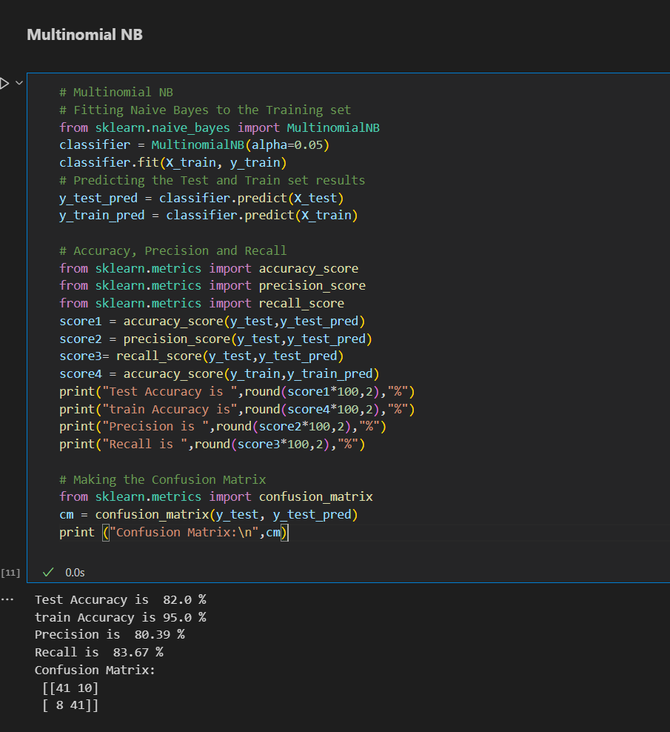
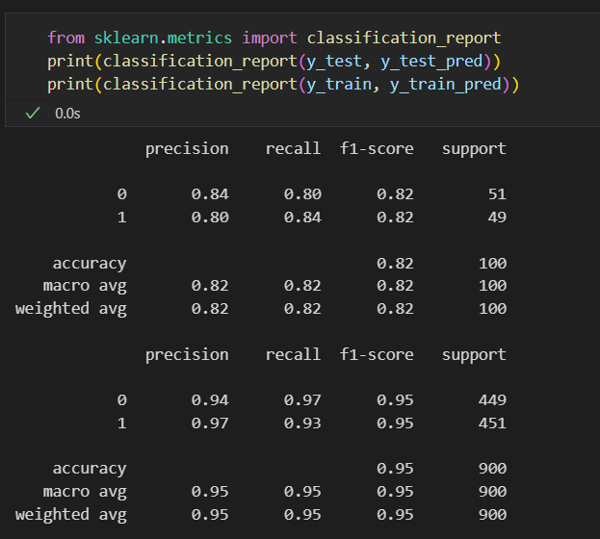
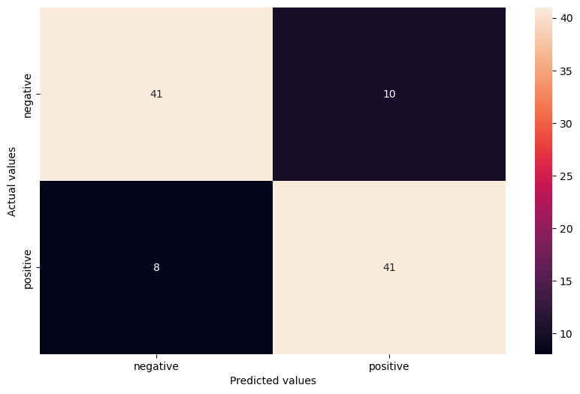
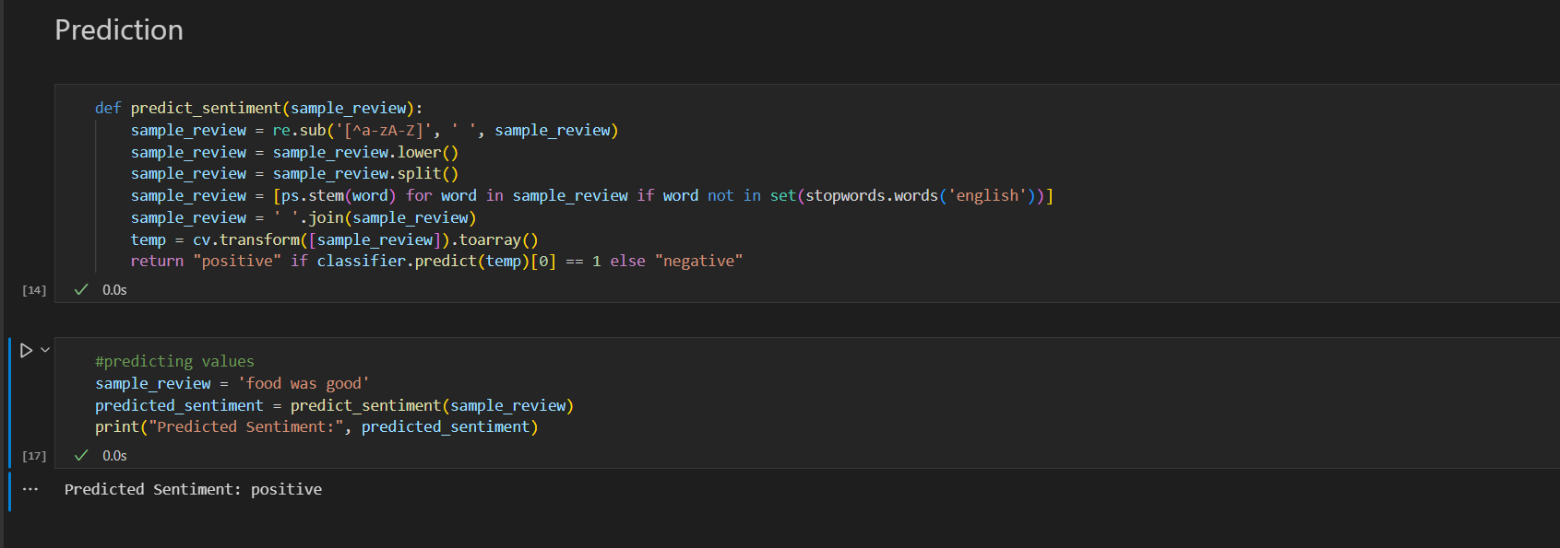
MODELLING

Slide 9
Results
The purpose of our project was to develop a sentiment analysis system for restaurant reviews, with the goal of providing actionable insights to restaurant owners and improving the overall dining experience. I used the Multinomial Naive Bayes (MultinomialNB) model for sentiment analysis and implemented various techniques to preprocess and analyze the data.
The model scored around 82% in testing accuracy and the full classification report is also shown in the code, which includes Precesion,Recall,F1 score for both positive and negative predictions.

Slide 10
links
The entire project is uploaded into a Git Repository (includes jupyter notebook, Dataset)
Github Link : https://github.com/Rohankurapati/AICTE_IBM

